Slide 1
E-Waste management system

Slide 2
Problem statement
Despite the adverse use of technological devices to achieve an economy that is driven by technology, there has been an alarm raised on what to do with obsolete technology due to lack of a better system of handling such crisis. There has been an increase in population in last decade for people who have learned to depend on the use of computing devices for their day to day activities making the number of end of life devices high and the only thing people do is store these devices in their stores or give them away to venders at a cost offer. The repair shops in town are becoming overwhelmed with non-functional devices with nowhere to take them and there arises a gap for a system that will help in coordinating a careful and secure collection and disposal of these devices.

Slide 3
Objective
The general objective of the study was to assess the e-waste landscape in Kenya and specifically Nairobi and come up with a system solution that will help manage the collection and disposal of e-waste.
Create a system that matches the user requirement.

Slide 4
Background overview
With increase in growth of use of these electronic devices comes a higher rate of obsolesce due to technological changes to fit the current changing needs and this means that there is need to come up with a mechanism of dealing with the disposal of this large chunks of computers putting in mind social and environmental consequences that arise such as issues to do with health care and pollution caused by non-biodegradable equipment’s.

Slide 5
Scope
It is limited to IT equipment; specifically personal computers (or desktop PCs), laptops (notebooks), cathode ray tube (CRT) and flat panel monitors, printers, and related computer accessories.

Slide 6
Justification
The project will be of great impact as if focuses on an issue that’s has been overlooked and given little attention. The main agenda of the project is to come up with e-waste management system that will touch on almost all sectors as ICT is highly embraced within Kenya. The main beneficiaries of this system will be National environmental management authority alongside the municipal council of Nairobi who are actively involved in the collection and disposal of waste.

Slide 7
Methodology
Requirement gathering and analysis
Interviews
Observation
Questionnaires

Slide 8
System minimum requirements
Hardware requirement
RAM at list 2GB
Back up disks like CD ROM and flash disk
Software requirement
Microsoft Windows (operating system)
Software development tool (Visual Studio Code)

Slide 9
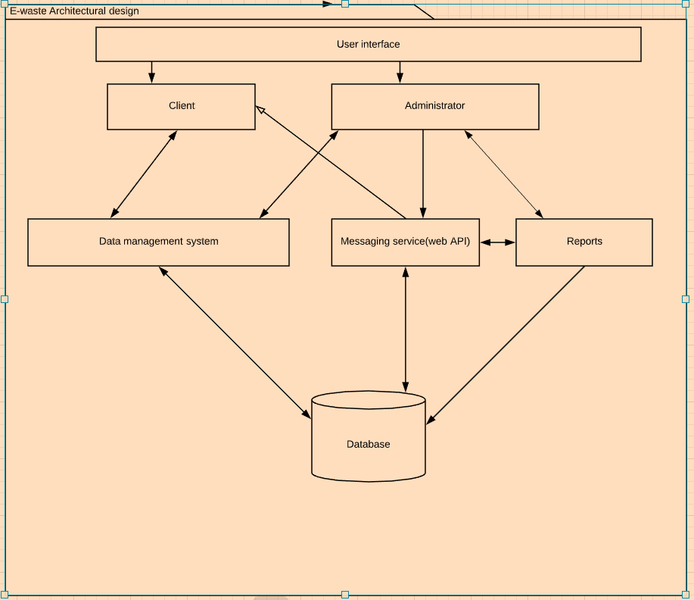
System design
Architectural Framework

Slide 10
Frontend software details
The frontend of the project is developed elegantly to support a user interface that is interactive in nature and simple to use for any user.
The technology stack for developing frontend application is:
HTML
CSS

Slide 11
Backend software details
The backend of the project is running on local machine and the database is connected to a local host. The database stores/views and retrieves the details collected from each client.
The technology stack for developing backend application is:
MySQL
PHP

Slide 12
Sample screenshots of the project

Slide 13
Frontend Samples

Slide 14
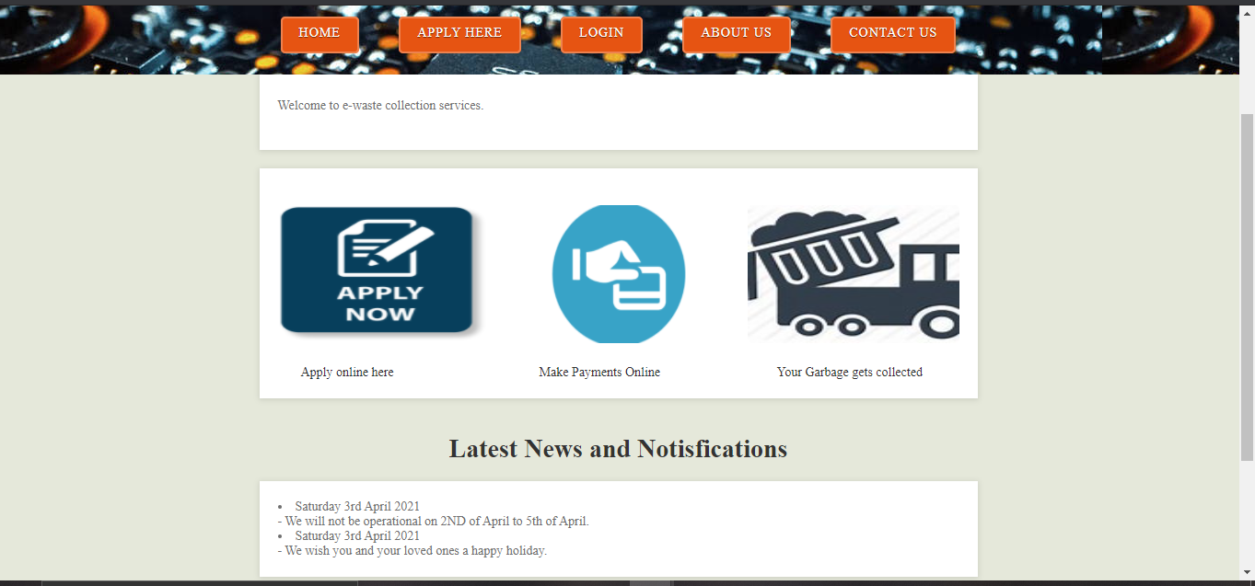
Home page

Slide 15
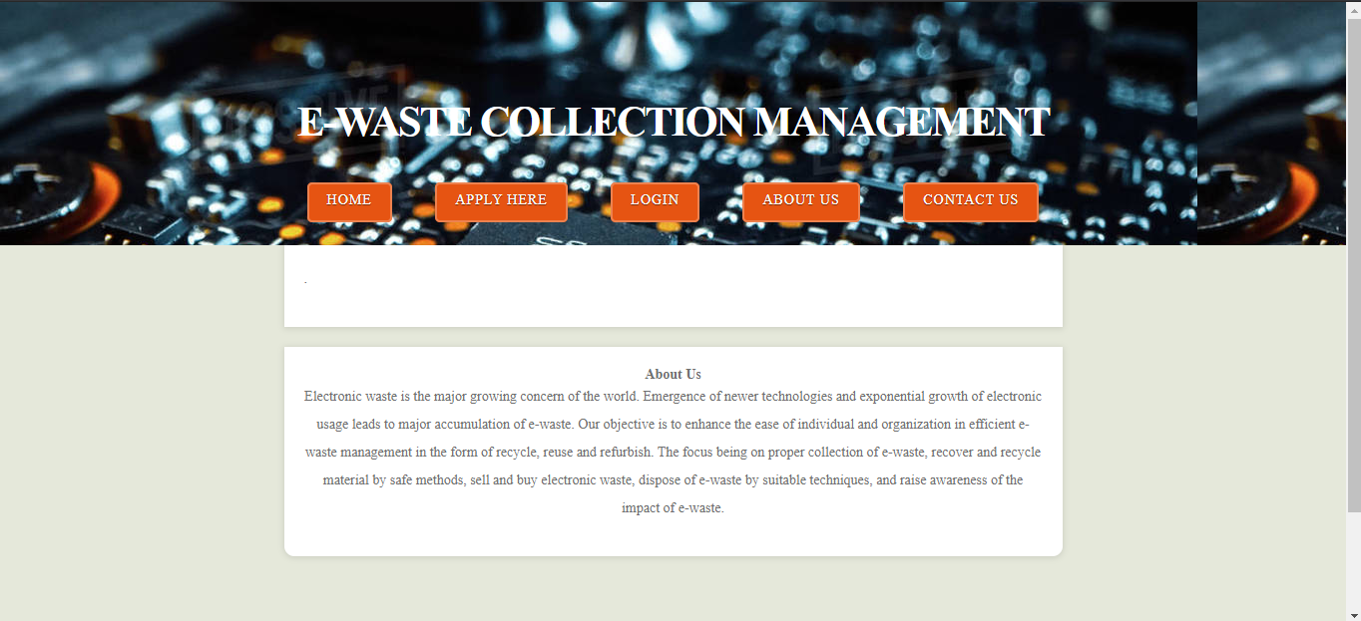
About Us

Slide 16
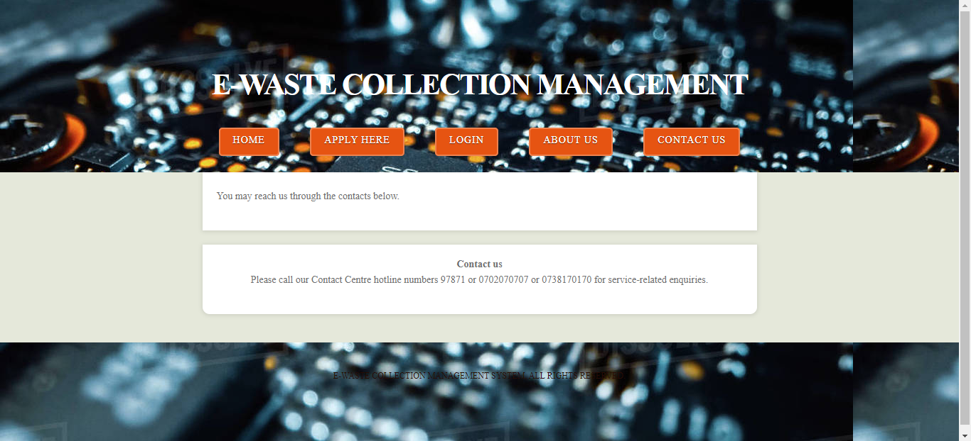
Contact us

Slide 17
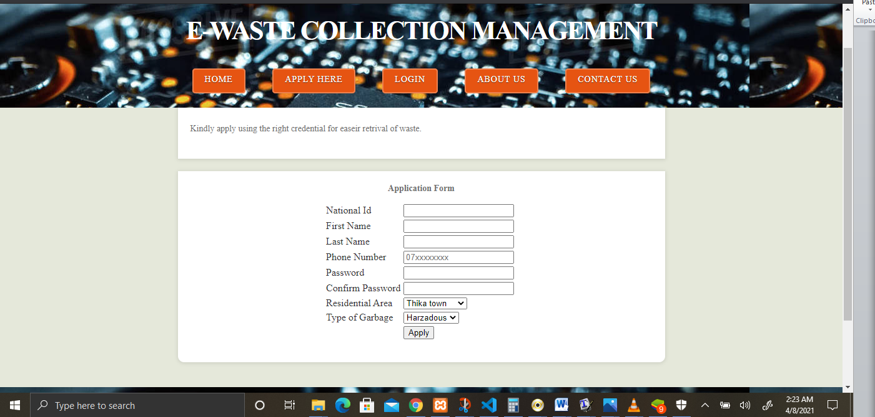
Sign-up

Slide 18
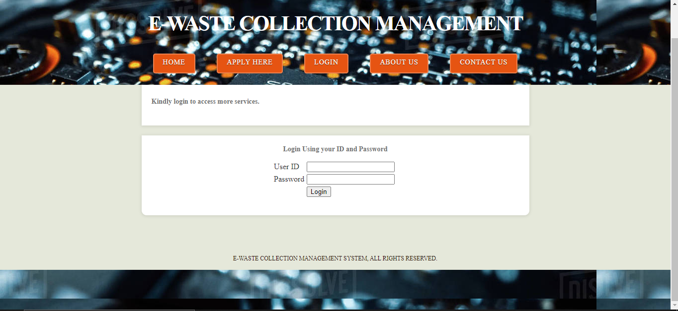
Login

Slide 19
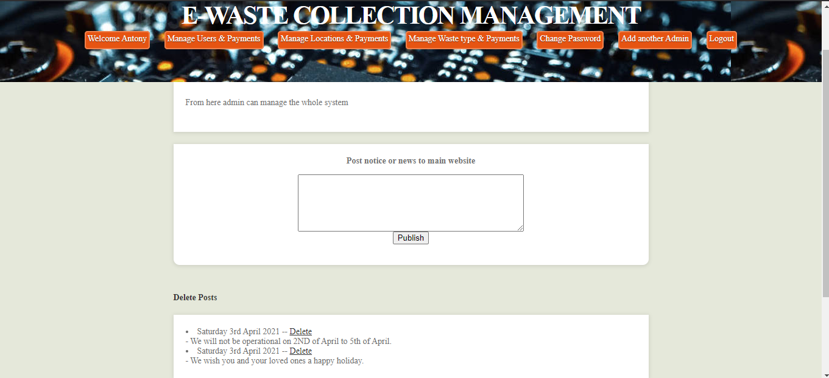
Admin panel
The admin can make, publish and delete notifications from this page.

Slide 20
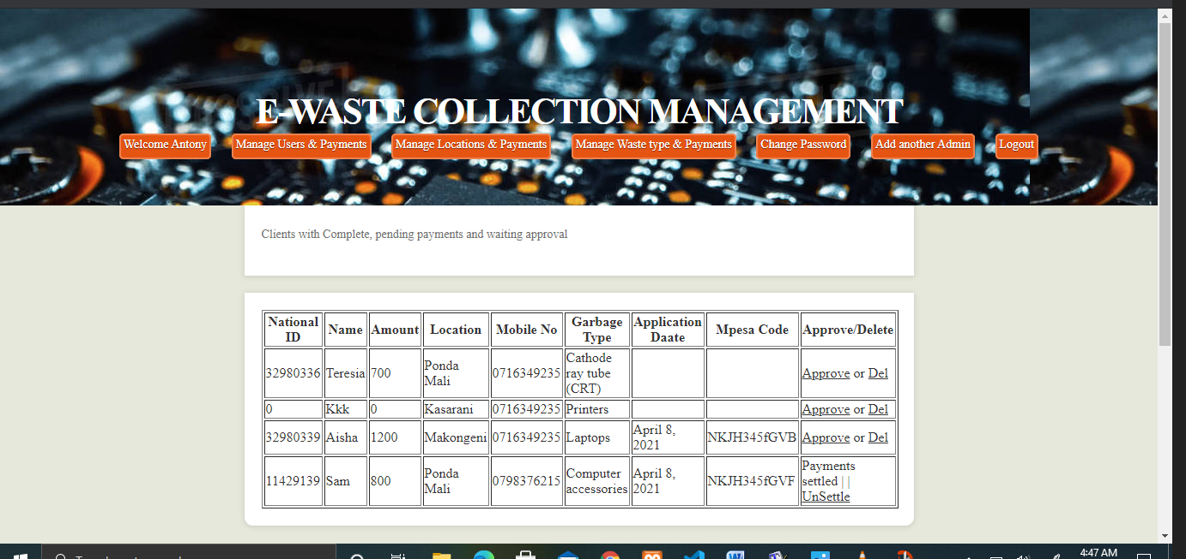
Admin manage users and payments.
The admin has the ability to view client detail along with the transactions made so that he can approve the collection of the waste upon payment.

Slide 21
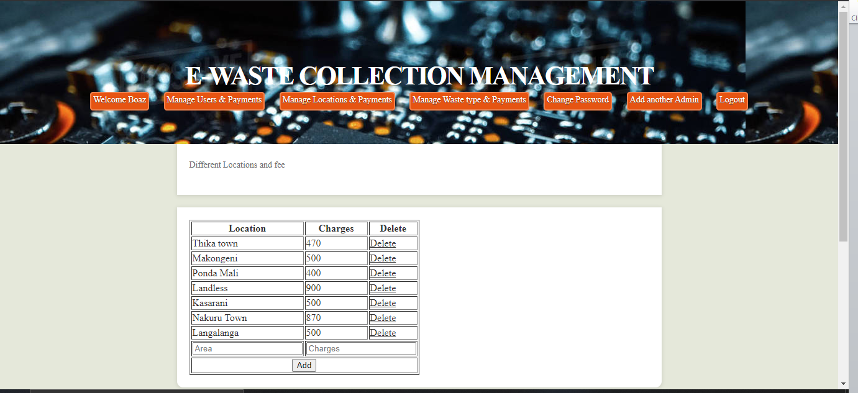
Admin manage location and payments.
Here the admin can add and delete a location and also make changes on the different charges that apply to the different location charges.

Slide 22
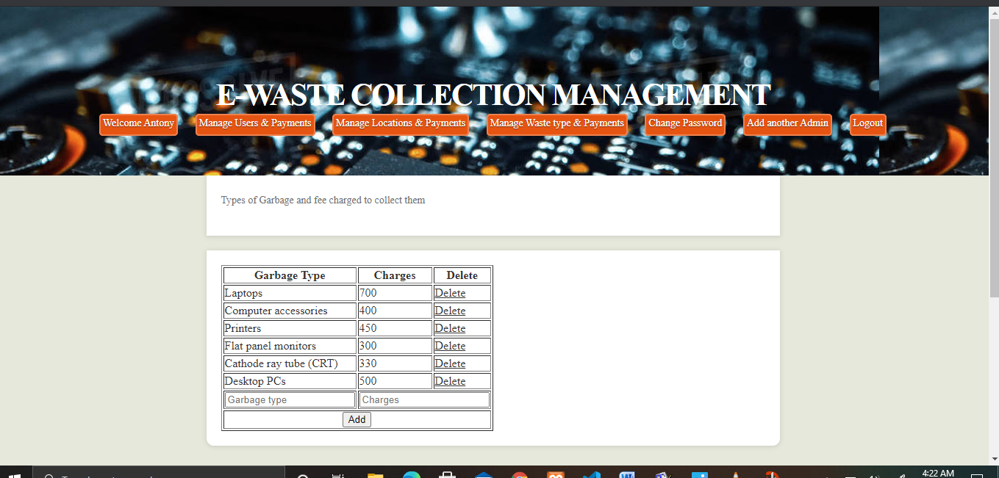
Admin manage waste type and payment.
The admin is able to add a waste type with its distinct price for collection. This page gives the admin the ability to change the prices for the waste along with the waste type. He/she is able to perform the functionality of update and deletion.

Slide 23
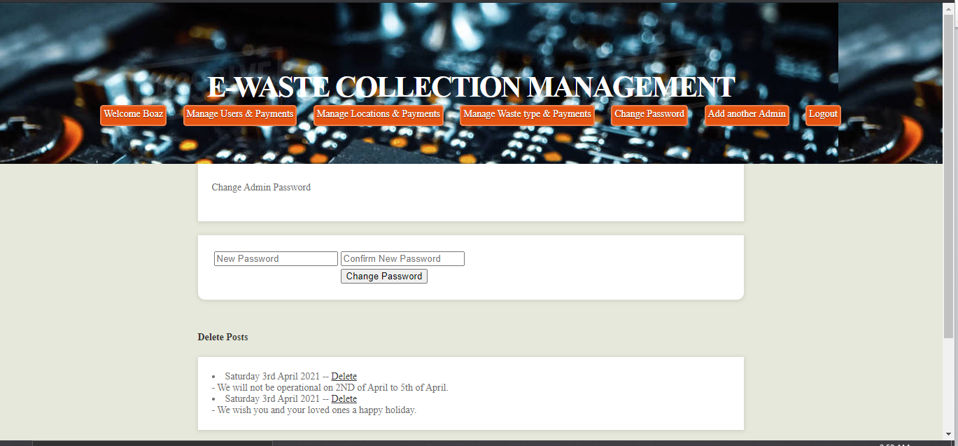
Admin manage password.
Each admin is able to manage individual password for security purposes.

Slide 24
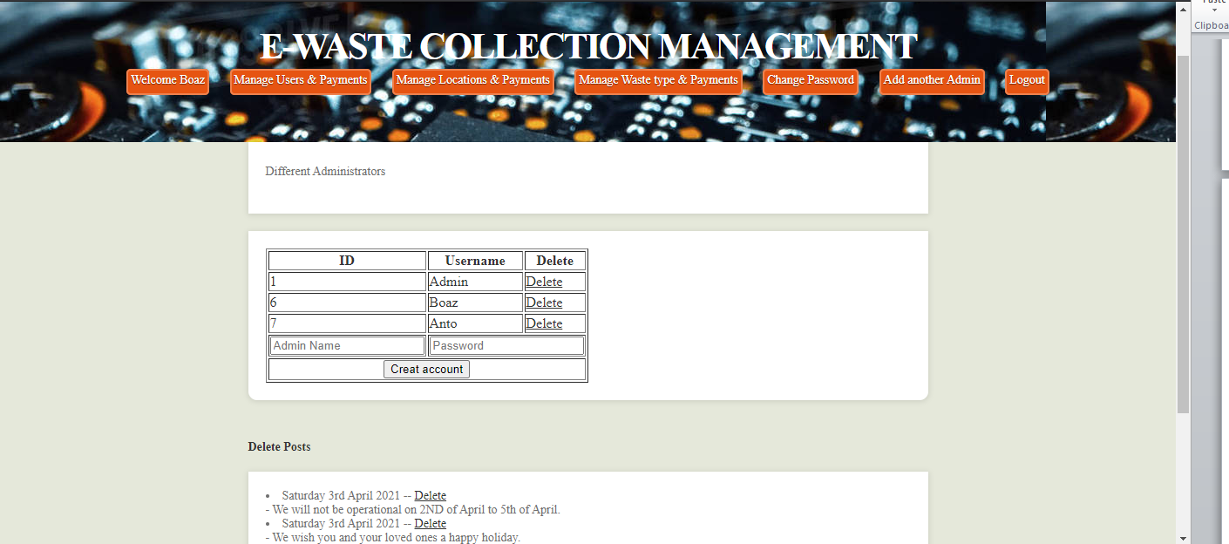
Admin manage other admins.
From this page the admin is able to add or remove another admin from the system.

Slide 25
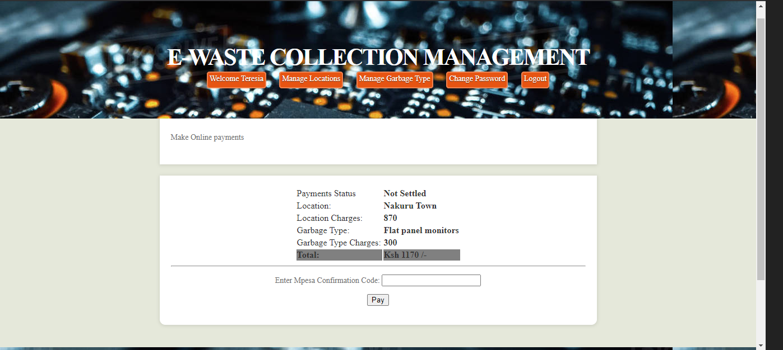
Client panel.
Upon login, the client gets to this page that indicate some of the details they provided during the application period.

Slide 26
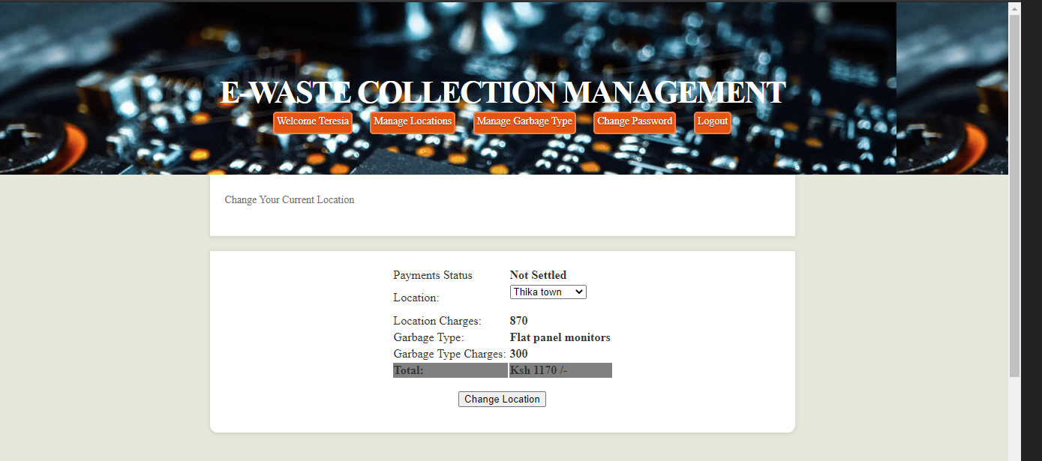
Client manage location.
The client can change the location where the waste is to be picked if for one reason or the other they indicated the wrong location during the application period. This gives them the chance to revert to a location of their choice.

Slide 27
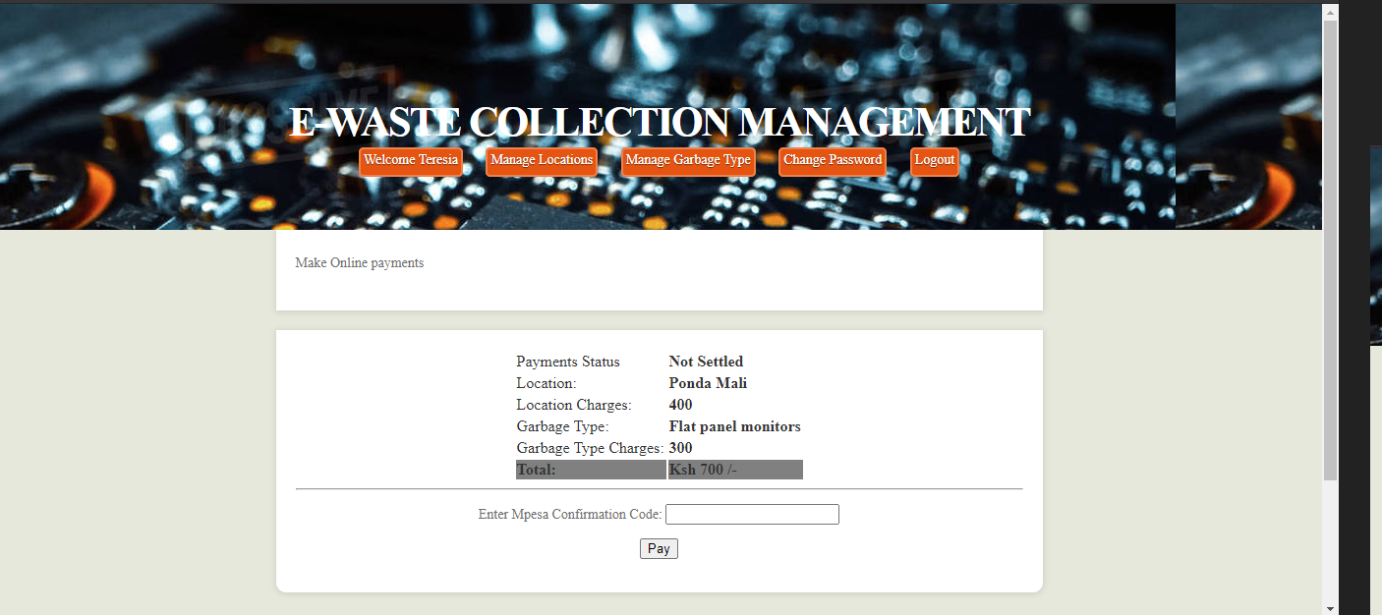
Client manage waste type.
From here the client can edit the waste type as indicated in the differences in the prices on fig18 and fig19 respectively with the change in amount paid per the waste type.

Slide 28
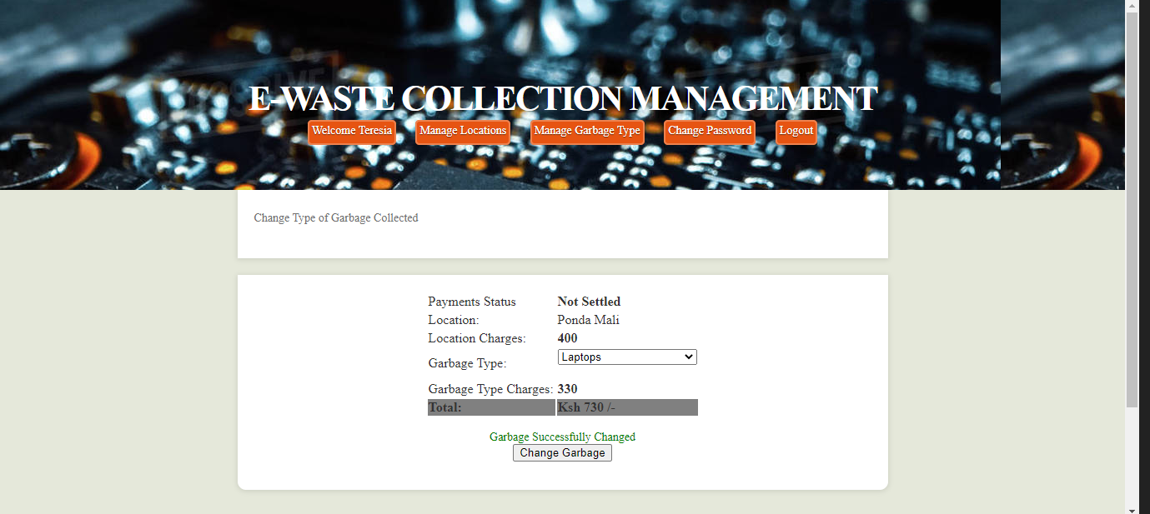
Client change waste type successfully

Slide 29
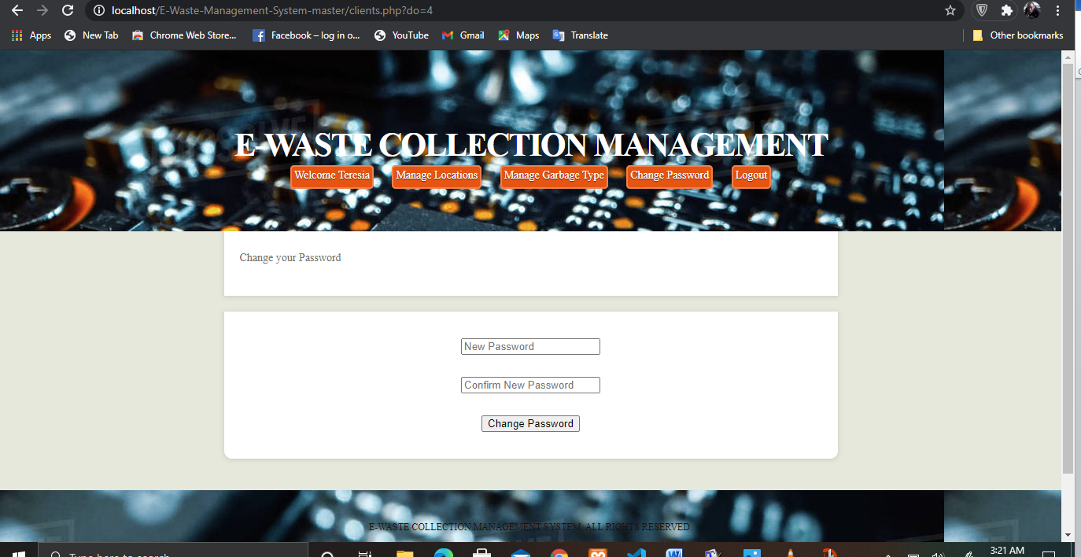
Client manage password.
The client has the ability to change the passwords

Slide 30
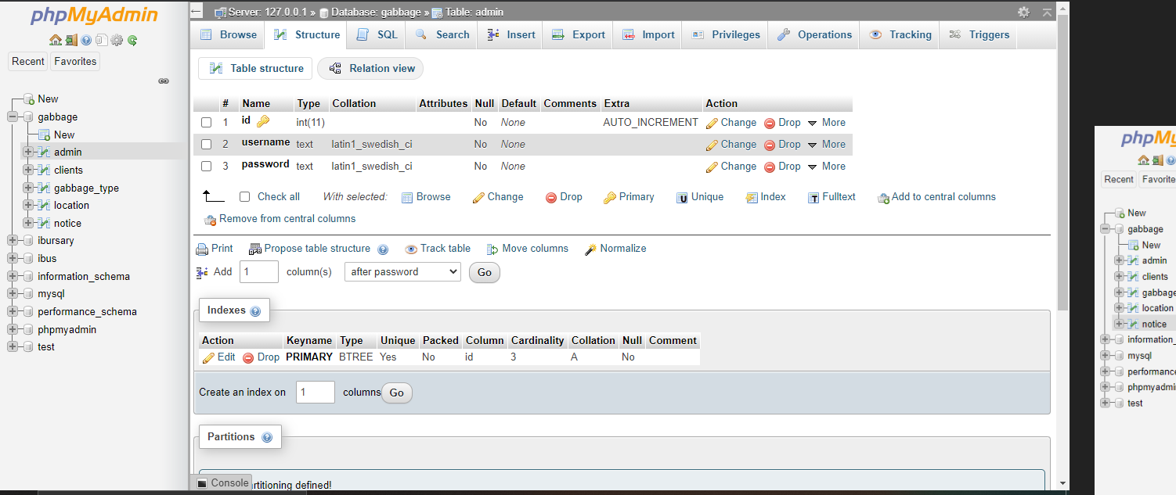
Backend database structure
Admin table.

Slide 31
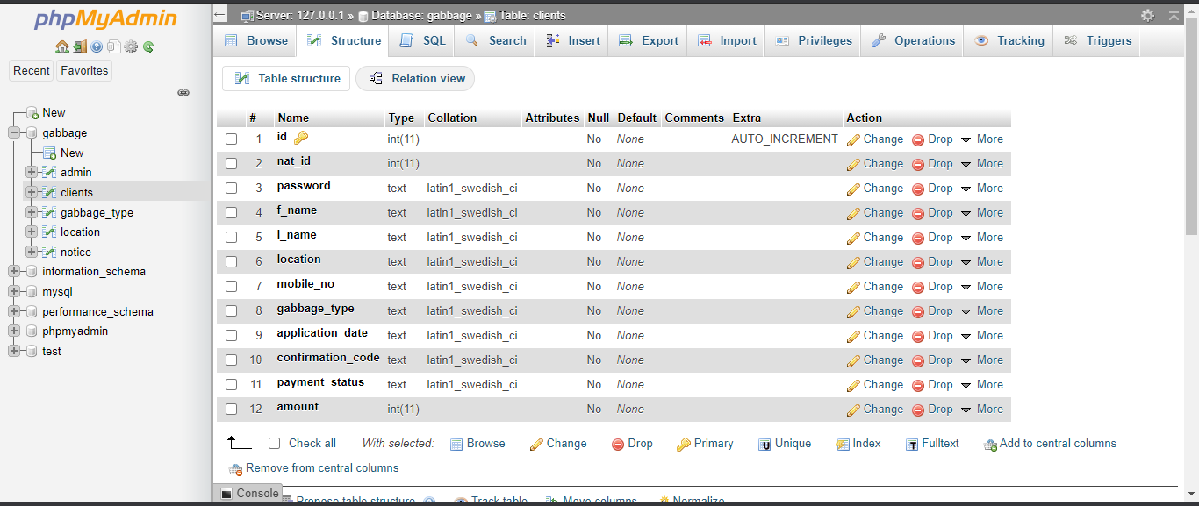
Client table.

Slide 32
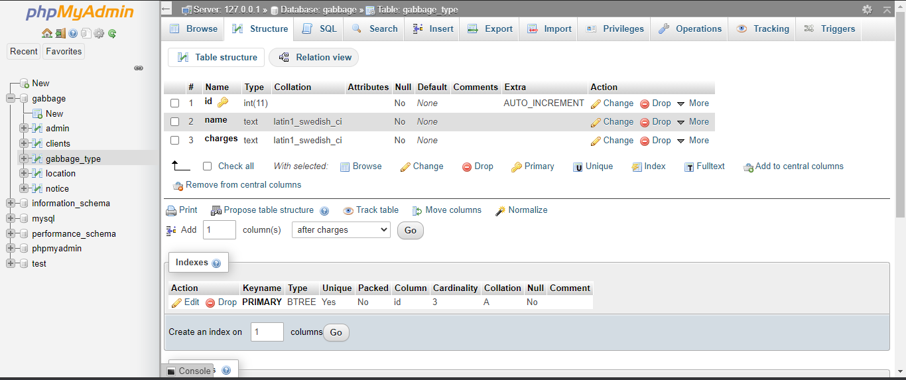
Garbage type table.

Slide 33
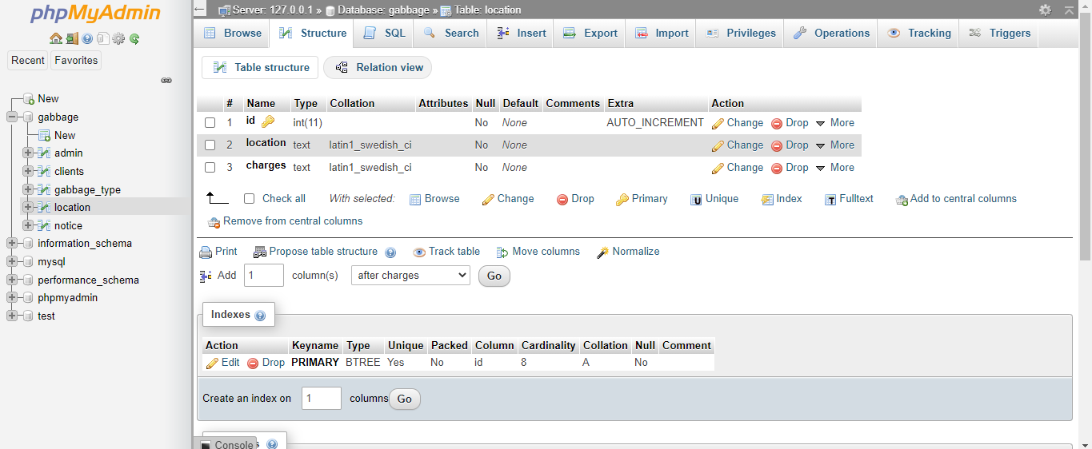
Location table.

Slide 34
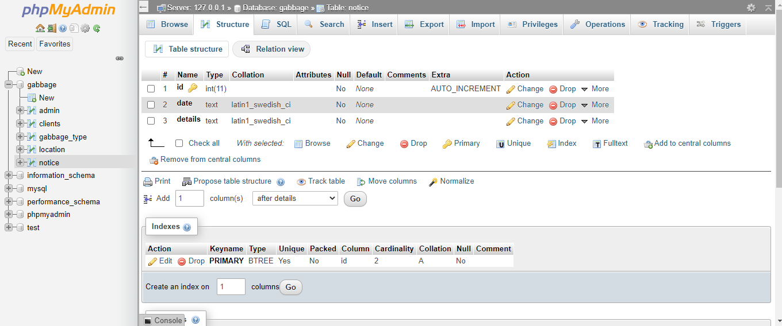
Notice table

Slide 35
System Testing
Unit testing
testing was performed on each modules during development.

Slide 36
Integration testing
A test was done during the integration of the modules into one software package.

Slide 37
System implementation
During this stage the system is up and running.
A direct approach is to be used during the implementation period as this is a new system.
The method is also advantageous as the system is not critical in nature

